Slide 1
PD 2.3 - Phase Il Project Demo (Team)
Sneha, Heron, Zinnia, Faisal, Aiah

Slide 2
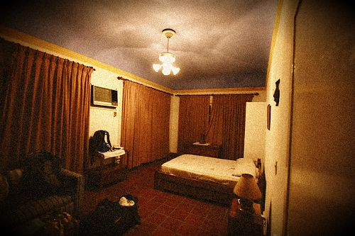
Business Understanding
The human trafficking crisis is a global issue affecting millions, often hidden in hotel rooms
Common challenge for law enforcement is identifying victim locations from limited visual evidence is time-consuming and error-prone.
Project Goal: Develop an AI model to match hotel room images to specific hotels.
Enhance law enforcement response time, improve victim rescue success, and demonstrate AI’s role in tackling human rights issues.
Notes:
Zinnia
Thousands of hotels with unique room designs make manual identification inefficient, which brings the need for automation
Leveraging AI and computer vision, this project will build an automated, scalable image recognition system for hotel room identification, addressing both societal and human rights needs.

Slide 3

Data Acquisition
Competition provided 15GB worth of hotel images as training data
Issues with using full dataset
Switched to running directly off of Kaggle
Notes:
Heron
Competition provided 15GB worth of hotel images as training data
Issues we had using the data set:
Running locally was slow because of CPU and many of us didn’t have 15GB of space
I wrote a script that simplified the data to 5GB but it was still hard to run and less accurate
AWS had a steep learning curve and none of us had experience, also only 5GB free version
Colab required us to purchase more Drive space, significant code changes to switch between environments
Why we switched to running directly off of Kaggle:
Easier environment, less of a learning curve
Can submit directly from Kaggle notebook to competition
Don’t need to download data or additional CSV files
Faster feedback

Slide 4
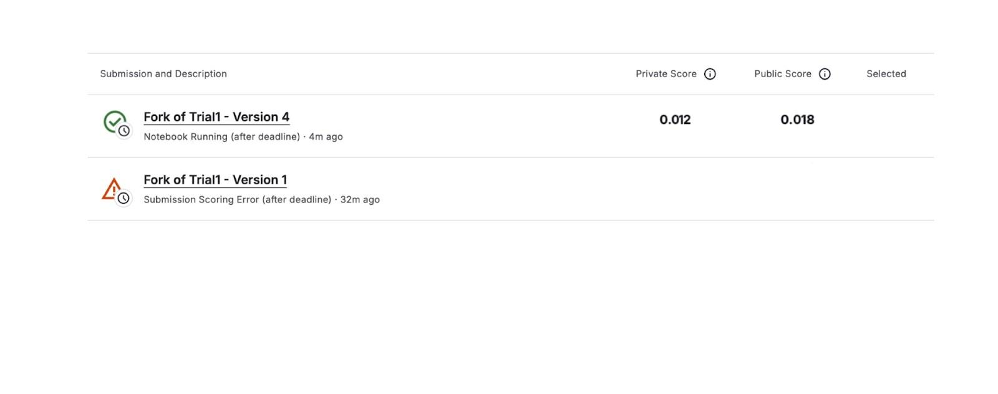
Baseline Model: Random Assignment
Establish a performance benchmark to test against our model
Extract full list of hotel IDs from dataset
For each test image, randomly assign 5 hotel IDs as predictions
Random model has an extremely low MAP@5 score as seen below.
Notes:
Aiah:
Objective: Establish a lower-bound baseline for performance comparison. Assign the 5 IDs without any model-based decision or considering image features.
A baseline model establishes a starting performance metric to compare against.
It helps us measure whether our models are actually improving or if observed changes in performance are just random fluctuations.
In this case, we use a random assignment approach as our baseline because it provides a purely chance-based result, making it the lowest possible benchmark.
How Random Assignment Works:
Extract the full list of hotel IDs from the dataset.
For each test image, randomly assign 5 hotel IDs as predictions.
Submit these predictions to Kaggle and evaluate the MAP@5 score.
Test baseline random assignment model against kaggle leaderboard to evaluate accuracy.this serves as a baseline for improvement with future models.

Slide 5
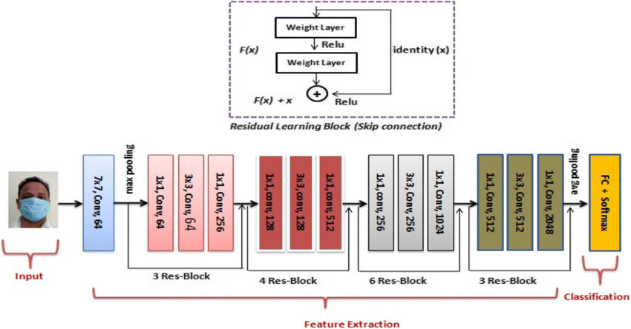
ResNet Architecture
Notes:
Aiah:
Input Layer: Show where the image enters the network.
Convolutional Blocks/Residual Blocks: Highlight key layers (e.g., 7×7 convolution, max pooling, and multiple residual blocks).
Skip Connections: Clearly mark the residual connections that enable deeper networks.
Global Pooling and FC Layers: Indicate how features are aggregated and then classified.
This figure illustrates the ResNet architecture. The input image first undergoes an initial convolution and max-pooling, followed by multiple residual blocks (shown with skip connections) that help combat vanishing gradients. Finally, a fully connected layer outputs the class probabilities (e.g., hotel IDs).
Chose to focus data augmentation on this residual design as it significantly improves training stability and model depth for image classification tasks.Residual connections improve gradient flow and model stability.
Input Layer & Preprocessing: Hotel room images are preprocessed to a fixed size (384×384) through padding, resizing, and normalization. This ensures that the model receives uniform input regardless of the original image dimensions or orientation.
Initial Convolutional Layer: The first convolution layer extracts low-level features (such as edges and textures) from the images. This step is crucial for capturing the basic visual details of diverse hotel room environments.
Residual Blocks (Skip Connections): Multiple residual blocks are used, each containing several convolutional layers with skip connections. These connections help the model learn deeper, more complex features while mitigating the vanishing gradient problem. They allow the network to capture subtle differences in hotel room designs.
Global Average Pooling: After feature extraction through residual blocks, global average pooling aggregates the spatial features into a fixed-length vector. This operation summarizes the learned features, making them more robust and reducing the number of parameters before classification.
Fully Connected Classification Layer: The condensed feature vector is fed into a fully connected layer, which outputs a probability distribution over the hotel ID classes. This layer directly predicts the most likely hotel IDs for each image.
Test-Time Augmentation (TTA): At inference, multiple augmented versions of each test image are processed, and their predictions are averaged. TTA improves model robustness by reducing uncertainty from variations in image orientation, lighting, and occlusions.

Slide 6

ResNet Model Setup
TIMM (Torchvision Image Models)
A python library that makes it easy to use powerful pre-trained deep learning models for computer vision tasks
It wraps around Pytorch and provides a single interface to load and modify models like RestNet, preventing us from the tedious task of coding neural networks from scratch
Fixed randomness- def seed_everything(seed): allows the model to behave consistently during training iterations
Neural networks involve randomness during weight initialization, shuffling data, and dropout layers
Without fixing the seed, the model might produce slightly different results each time, even with the same data
Notes:
Zinnia
Training a deep learning model from scratch is like teaching a child how to recognize objects from nothing."
But with timm:
The model is already trained on large datasets like ImageNet — which contains over 14 million images across 1,000 categories (dogs, cats, cars, etc.).
Even though this project involved hotel rooms (which aren't in ImageNet), the model already "knows" how to recognize patterns like:
Shapes
Textures
Lighting
Colors
This means the model starts with general pattern-recognition ability — we just need to "fine-tune" it to the specifics of hotel rooms.
Fixed Randomness
We need the model to behave consistently every time we train it

Slide 7
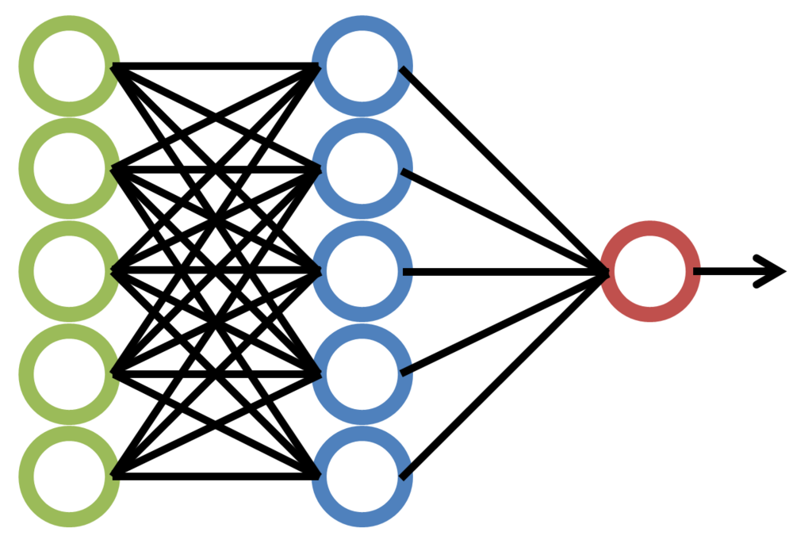
ResNet Data Processing
Padding Function
Neural networks expect all input images to be the same size; Some images might be portrait, and others landscape
Padding adds black pixels to make sure that the image is square without distorting it
Notes:
Zinnia
Padding Function- the input images are not always square, so we need to standardize them

Slide 8
Attempted ResNet Data Augmentations
Enhanced Occlusion Handling
Added GridDropout
Suggested CutMix
Improved Color Transformations
Added CLAHE
Added ChannelShuffle
Introduced ToGray for partial grayscale conversion.
Additional Spatial Augmentations
Implemented GridDistortion
Added MotionBlur
Introduced Gaussian Noise
Notes:
Heron
Enhanced Occlusion Handling
Added GridDropout for structured occlusion patterns.
Suggested CutMix for blended class-mixed augmentation.
Improved Color Transformations
Added CLAHE for better contrast adjustment.
Added ChannelShuffle to randomize color channels.
Introduced ToGray for partial grayscale conversion.
More Diverse Geometric Transformations
Added PiecewiseAffine to introduce non-linear distortions.
Used RandomResizedCrop instead of RandomCrop for better resizing.
Added Shear Transformations with Affine.
Additional Spatial Augmentations
Implemented GridDistortion for warping effects.
Added MotionBlur to simulate object movement.
Introduced Gaussian Noise for robustness to real-world artifacts.

Slide 9
Attempted ResNet Data Augmentations
Color Augmentation
RGBShift
ShiftScaleRotate parameters adjusted
Notes:
Heron
Color Augmentation
Baseline: .181
+ RGBShift 25% - .181
RGBShift 50% - .181
SaltAndPepper - Doesn’t exist in this version?
ShiftScaleRotate parameters adjusted:
shift_limit=0.0625
scale_limit=0.1
rotate_limit=10
interpolation=cv2.INTER_NEAREST
Data loading: hotel_id_code_map = hotel_id_code_df.set_index('hotel_id_code').to_dict()["hotel_id"]
Fixed GPU and CPU errors with train set (used inference training set)

Slide 10
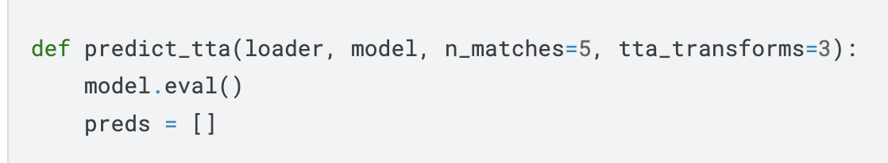
What is Test-Time Augmentation (TTA)?
Definition: Applies transformations to test images to improve model generalization.
Why use TTA?
Handles variations, reduce uncertainty.
How it works:
n_matches=5, tta_transforms=3:
Model processes multiple augmented versions of each test image.
Predictions from all versions are averaged for stability.
Notes:
FAISAL
Definition: Test-Time Augmentation (TTA) applies transformations to test images to improve model generalization.
Why use TTA?
Handles variations in lighting, angles, and distortions.
Averages predictions from multiple augmented versions of the same image to reduce uncertainty.
How it works:
n_matches=5: Returns the top 5 most confident predictions per image.
tta_transforms=3: Generates 3 augmented versions of each image to improve robustness.
Multiple augmented versions of a test image are generated and passed through the model.
The model produces predictions for each augmented version.
Final prediction is obtained by averaging or voting among these predictions to increase stability and reduce noise.

Slide 11
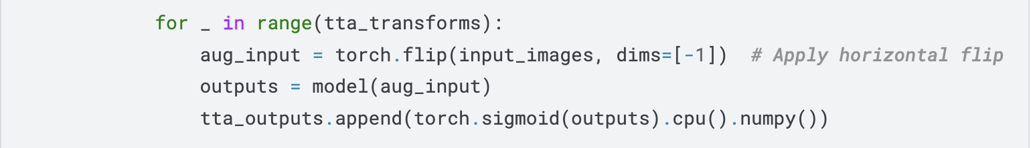
How Was TTA First Applied?
Original TTA (public score increased (.166 -> .181):
Why only horizontal flipping?
Notes:
FAISAL
Original TTA (public score increased (.166 -> .181):
So why was Only horizontal flipping was used as augmentation.
It’s key structural features without distorting spatial relationships.
Compensates for slight differences in camera perspective.
Introduces minimal risk of artifacts compared to other augmentations.
Works well with symmetrical hotel layouts and feature consistency.
Goal: Improve recognition of hotels with slight variations in input images.

Slide 12
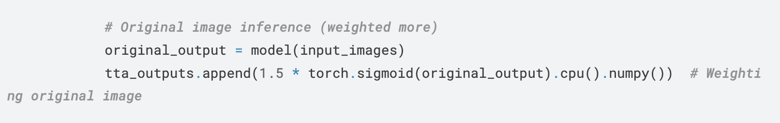
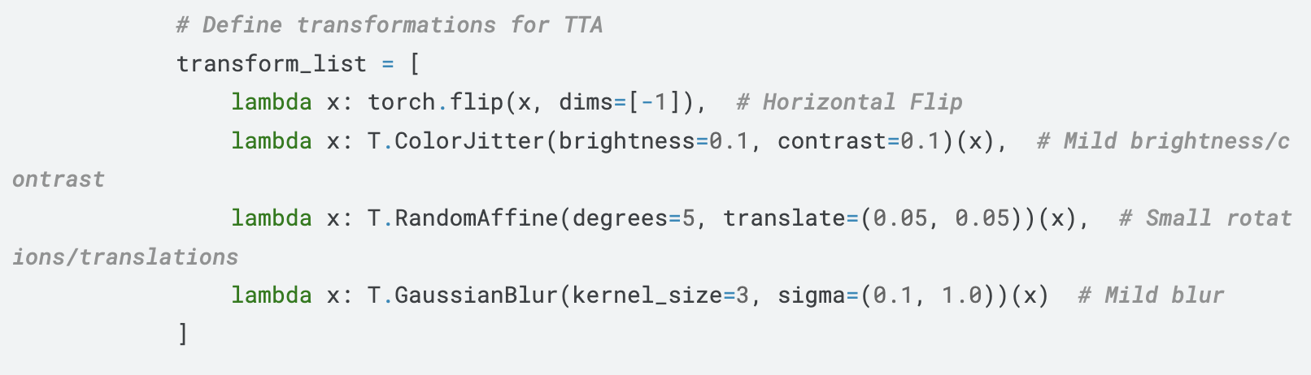
Performance Impact of Each Change
Original TTA (public score increased (.181 -> .182):
Weighted Original Prediction ->
Additional Augmentations ->
Improvement | Impact on Accuracy
Weighted Original Prediction | Improved
Additional Augmentations | Decreased
Notes:
FAISAL
Weighted Original Prediction Worked:
1.5x weighting on the original image improved prediction stability:
Anything beyond 1.5x may lead to overfitting to the original image’s noise and potential errors, rather than leveraging augmentation benefits… the key is balance
Reduced reliance on noisy augmentations, maintaining focus on meaningful patterns.
Ensured the model prioritized high-confidence features from the original image while still leveraging slight augmentations.
Prevented overfitting to augmented variations by stabilizing predictions and reducing inconsistencies across TTA-generated images.
Additional Augmentations Hurt Performance:
Over-processing images introduced distortions rather than useful variation, leading to feature misinterpretation.
Certain augmentations (e.g., brightness shifts, blur, rotations) altered key details, making it harder for the model to recognize consistent patterns across images.
Color Jitter (±10% brightness/contrast): Simulates lighting differences, but too much can distort image details.
Small Rotations (±5°) & Translations (±5%): Mimics slight camera movements, but larger values misalign features.
Gaussian Blur (sigma 0.1–1.0): Reduces reliance on sharp edges, but excessive blur erases fine details.
Instead of improving generalization, these transformations sometimes forced the model to adapt to unrealistic variations, reducing MAP@5 performance.

Slide 13
Performance Evaluation of ResNet Model
With the improved ResNet-34 Model (with updated TTA) we saw improvement in MAP@5, public score (from 0.156 to 0.182).
Notes:
FAISAL
In the end……
Professor Note: keep original images as well as the augmented images for all augmentation code

Slide 14
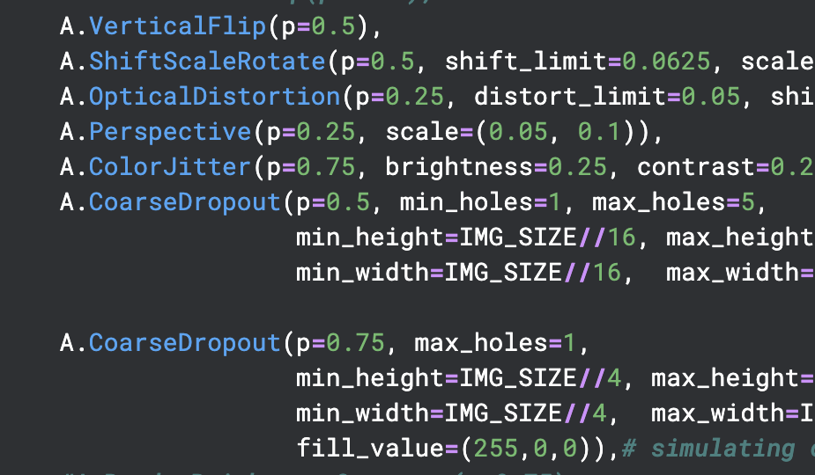
EfficientNet Data Processing
Flip Vertically
Rotate and Zoom
Making the image concave inwards
Shift Perspective
Change hue and saturation
Simulate Masks
Notes:
Sneha
Padding Function- the input images are not always square, so we need to standardize them

Slide 15
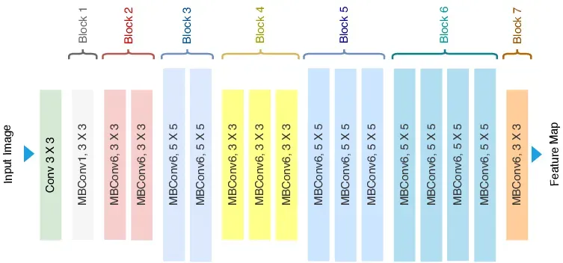
EfficientNet Model Setup: Training Model
Uses image augmentation to increase the number of images to work with, while also decreasing the chance of overfitting
Trains images using a checkpoint system and an EfficientNet model
After checkpoint system, the model is trained using a similarity test
Finally, model is put in evaluation mode, then generates embeddings of both images and the model
Notes:
Sneha
Training a deep learning model from scratch is like teaching a child how to recognize objects from nothing."
But with timm:
The model is already trained on large datasets like ImageNet — which contains over 14 million images across 1,000 categories (dogs, cats, cars, etc.).
Even though this project involved hotel rooms (which aren't in ImageNet), the model already "knows" how to recognize patterns like:
Shapes
Textures
Lighting
Colors
This means the model starts with general pattern-recognition ability — we just need to "fine-tune" it to the specifics of hotel rooms.
Fixed Randomness
We need the model to behave consistently every time we train it

Slide 16
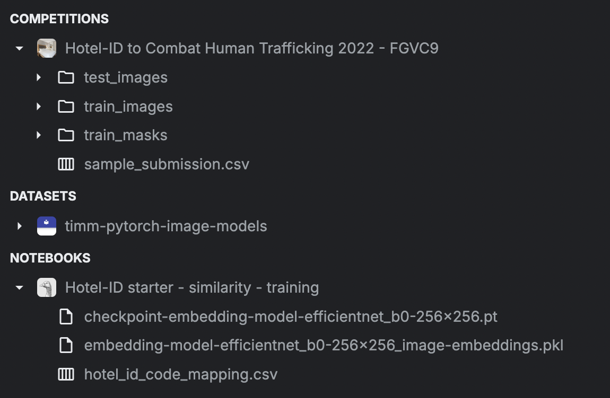
EfficientNet Model Setup: Prediction Model
Takes input of embeddings from previous notebooks and competition files
Uses the image and model embeddings to help create testing model
Use cosine similarity distance model to predict 5 closest matches to target

Slide 17
Performance Evaluation of EfficientNet Model
With the functional EfficientNet Model we saw improvement from ResNet model.
However, the EfficientNet Model takes several hours to generate embeddings, and the prediction model almost entirely relies on the embeddings, so testing features is slow in this model
Notes:
Sneha
Next steps would be to fine tune EfficentNet/ResNeXt to further improve MAP@5. Experiment with And explore

Slide 18
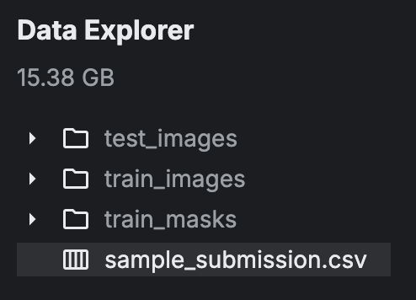
Model Deployment
Storage
The competition has 44.7k files for analysis that was about 15 GB of data, which was too much for our computers to handle
Fixed issue by:
Used Kaggle interface which has all data pre-downloaded
Efficient Net and ResNet models are successfully being ran and scored
Notes:
Sneha

Slide 19
Integrating DINOv2
Prototype Phase: Develop small-scale implementation to verify DINOv2’s performance.
Full Integration: Replace the ResNet backbone in the existing pipeline.
Hyperparameter Tuning: Adjust training parameters to suit DINOv2’s architecture.
Benchmarking: Compare performance against the baseline (ResNet/EfficientNet) using the same metrics.
Notes:
Aiah
This slide presents our proposed integration of DINOv2 into our hotel ID classification pipeline.
DINOv2 is a state-of-the-art self-supervised model that produces high-quality embeddings by capturing nuanced spatial and semantic details. These robust feature representations can significantly enhance our model's ability to differentiate between similar hotel images, thereby improving overall classification performance.
The inspiration to incorporate DINOv2 came from discussions with Andrea at the Souvenir Lab—a team of engineers specializing in image classification. They demonstrated that self-supervised learning techniques like DINOv2 often outperform traditional methods such as ResNet in extracting meaningful features from images. By replacing or complementing our current ResNet-based embeddings with those generated by DINOv2, we anticipate not only a higher MAP@5 score but also better generalization across diverse hotel images. This approach aligns our project with cutting-edge computer vision research and strengthens its potential for real-world law enforcement applications."

Slide 20

Future Plans
Work on feature augmentations on the ResNet Model
Implement improvements from the TTA model onto the Efficient model
Create interactive dashboard via ‘gradio.app’
Get the DINOv2 Model involved;
DINOv2 is considered a state of the art method for self-supervised learning and feature extraction, ultimately outperforming older models like ResNet in certain tasks.
This method learns high-quality representations that capture more details
Notes:
Aiah
lnclude a source to upload the photo in question. Once the photograph is uploaded, a list of the hotels with the most likely hotel match will be presented to the user.
Switching from ResNet to DINOv2 could offer various benefits, like better generalizations and more enhanced feature extraction.
and its embeddings can be directly compared using FAISS or cosine similarity, making DINOv2 most ideal for retrieving similar hotel images as FAISS or cosine similarity is most helpful for embedding-based retrieval.
To enhance the model, incorporating the ResNet data augmentation features that we found successful into this the DINOv2 to improve overall score.
Model takes hours to generate, sometimes with failure, so testing features is slow.

Slide 21
Metrics
 | Run time | MAP@5 | Notes
Random Assignment | 5-10 minutes | 0.012 | Baseline using random hotel ID predictions.
EfficientNet-b0 | 8+ hours | 0.204 | Demonstrated improvement over ResNet; however, embedding generation is slower.
ResNet-34 Baseline | 15 min | 0.156 | Initial performance without TTA enhancements.
ResNet-34 w/ TTA | 30 minutes | 0.182 | Improved score after applying Test-Time Augmentation (TTA).
DINOv2 | 2-3 hour | 0.174 | Strong feature extraction with self-supervised learning; slightly lower than ResNet-34 with TTA.
It is important to note that we do not claim one model is definitively superior to another. Instead, each model contributes unique insights, and their performance is converging towards improving our overall MAP@5 score. This multi-model approach allows us to validate improvements across different methods and ultimately refine our system for more robust hotel ID classification.
Notes:
ZINNIA:
This table shows the progression from a random baseline to a ResNet-34 model enhanced with TTA, and includes a note on the EfficientNet model’s performance improvements despite slower inference due to embedding extraction.

